Slide 1
Regression

Slide 2
What We’ll Cover
What is regression?
How does linear regression look like?
How does linear regression learn?

Slide 3


What is regression?

Slide 4
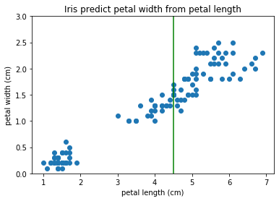
What is regression?
Predicting numerical values from a continuous, or large discrete, number range
Notes:
Photo: https://www.flickr.com/photos/107442568@N08/12547327134

Slide 5
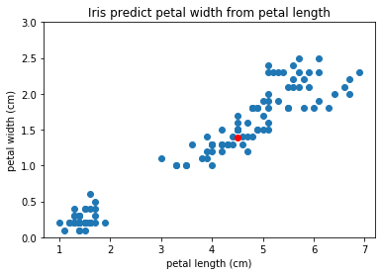
What is regression?
Predicting numerical values from a continuous, or large discrete, number range
Notes:
Photo: https://www.flickr.com/photos/107442568@N08/12547327134

Slide 6
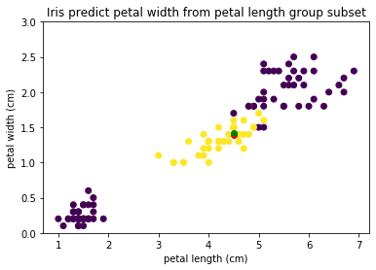
What is regression?
Predicting numerical values from a continuous, or large discrete, number range
Applications like
Sales
Temperature
Demand
Energy requirements
...
Notes:
Photo: https://www.flickr.com/photos/107442568@N08/12547327134

Slide 7
Linear Regression

Slide 8
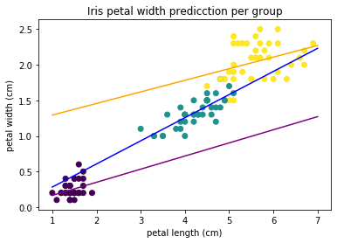
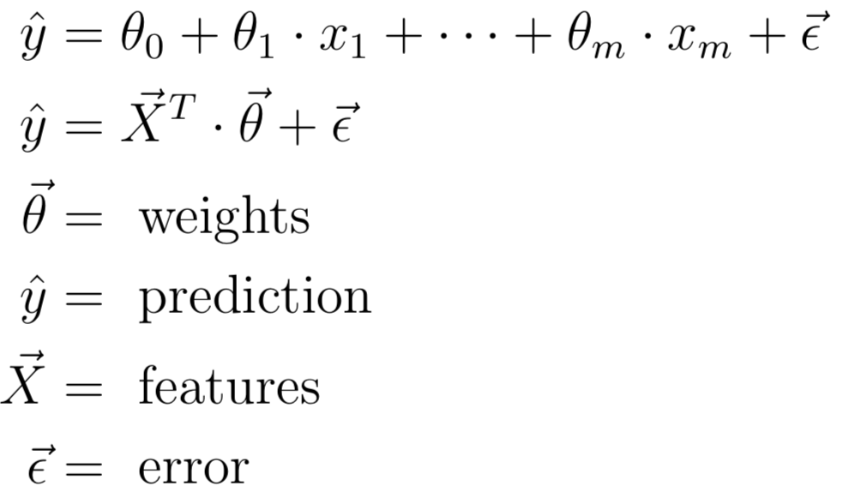
How does Linear Regression look like?
Estimate parameters of linear regression
Notes:
Photo: https://p0.piqsels.com/preview/75/886/497/4480j35547m45663a3pm5fmsvd.jpg

Slide 9
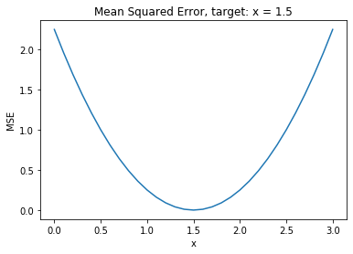

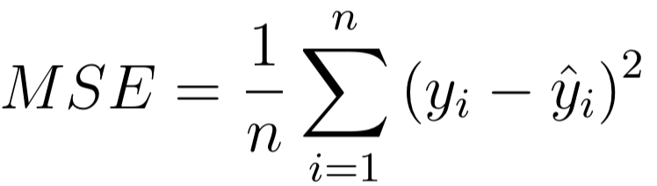
How does Linear Regression learn?
Loss function
MSE
MAE
y - target
- prediction
n - observations
Notes:
Photo: https://p0.piqsels.com/preview/75/886/497/4480j35547m45663a3pm5fmsvd.jpg

Slide 10
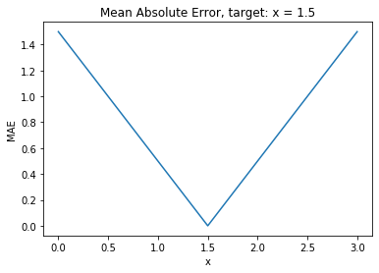
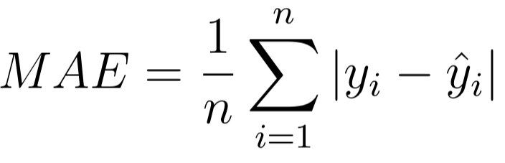
How does Linear Regression learn?
Loss function
MSE
MAE
y - target
- prediction
n - observations
Notes:
Photo: https://p0.piqsels.com/preview/75/886/497/4480j35547m45663a3pm5fmsvd.jpg

Slide 11
How does Linear Regression learn?
Loss function
MSE
MAE
y - target
- prediction
Convex functions by nature -> local minimum = global minimum
Notes:
Photo: https://p0.piqsels.com/preview/75/886/497/4480j35547m45663a3pm5fmsvd.jpg

Slide 12
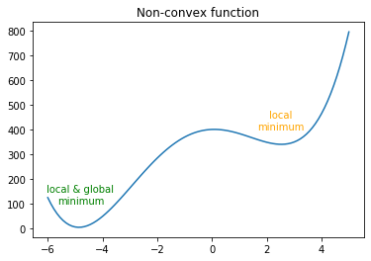
How does Linear Regression learn?
Loss function
MSE
MAE
y - target
- prediction
Notes:
Photo: https://p0.piqsels.com/preview/75/886/497/4480j35547m45663a3pm5fmsvd.jpg

Slide 13

Linear Regression Modifications
Loss function
MSE
MAE
y - target
- prediction
Notes:
Photo: https://p0.piqsels.com/preview/75/886/497/4480j35547m45663a3pm5fmsvd.jpg

Slide 14
Linear Regression Modifications
Loss function
MSE
MAE
y - target
- prediction
Extra = L2 regularization -> Ridge Regression
Notes:
Photo: https://p0.piqsels.com/preview/75/886/497/4480j35547m45663a3pm5fmsvd.jpg

Slide 15
Linear Regression Modifications
Loss function
MSE
MAE
y - target
- prediction
Extra = L2 regularization -> Ridge Regression
Extra = L1 regularization -> Lasso Regression
Notes:
Photo: https://p0.piqsels.com/preview/75/886/497/4480j35547m45663a3pm5fmsvd.jpg

Slide 16
Linear Regression Modifications
Loss function
MSE
MAE
y - target
- prediction
Extra = L2 regularization -> Ridge Regression
Extra = L1 regularization -> Lasso Regression
Extra = L1 +L2 reg. -> ElasticNet
Notes:
Photo: https://p0.piqsels.com/preview/75/886/497/4480j35547m45663a3pm5fmsvd.jpg

